Slide 1
Backpropagation

Slide 2
Outline
What is Back Propagation?
Optimizing one parameter
Optimizing multiple parameters

Slide 3
What is Backpropagation?
Backpropagation is the process of adjusting the parameters of a neural network by analyzing the loss from the previous iteration

Slide 4


Slide 5
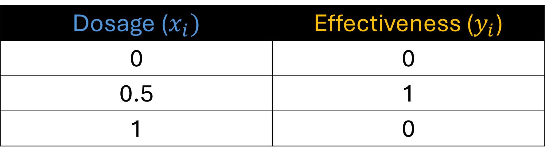
Training Data
Dosage ($x_{i})$ | Effectiveness ($y_{i}$)
0 | 0
0.5 | 1
1 | 0
Imagine that we have a dataset containing the amount of dosage given to a patient and their effectiveness where 0 is not effective and 1 is effective.

Slide 6
Training Data
Dosage ($x_{i})$ | Effectiveness ($y_{i}$)
0 | 0
0.5 | 1
1 | 0
Let us call all inputs $x_{i}$ and our observed outputs $y_{i}$. We will these inputs and run them to our neural network.

Slide 7
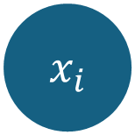



This is the neural network that we will train using our small dataset
$$b$$
$${ x}_{i}$$
$$b$$
$$b$$
Input Layer
Hidden Layer
Output Layer

Slide 8
Our neural network contains 1 hidden layer with 2 neurons.
$$b$$
$${ x}_{i}$$
$$b$$
$$b$$
Input Layer
Hidden Layer
Output Layer

Slide 9
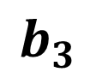
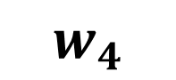
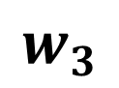
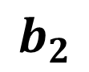
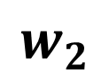
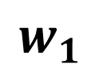
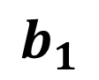
$$b_{1}$$
Our neural network has a total of 7 parameters, let us name each of our parameter…
$$b$$
$$w_{1}$$
$$w_{3}$$
$${ x}_{i}$$
$$b_{3}$$
$$b$$
$$w_{2}$$
$$w_{4}$$
$$b$$
$$b_{2}$$
Input Layer
Hidden Layer
Output Layer

Slide 10

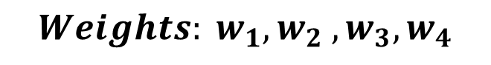
$$b_{1}$$
$$Weights: w_{1},w_{2} ,w_{3},w_{4}$$
$$b$$
$$Biases: b_{1},b_{2},b_{3}$$
$$w_{1}$$
$$w_{3}$$
$${ x}_{i}$$
$$b_{3}$$
$$b$$
$$w_{2}$$
$$w_{4}$$
$$b$$
$$b_{2}$$
Input Layer
Hidden Layer
Output Layer

Slide 11
$$b_{1}$$
In practice, the weights and biases are initialized with a random value.
$$b$$
$$w_{1}$$
$$w_{3}$$
$${ x}_{i}$$
$$b_{3}$$
$$b$$
$$w_{2}$$
$$w_{4}$$
$$b$$
$$b_{2}$$
Input Layer
Hidden Layer
Output Layer

Slide 12







$$???$$
In practice, the weights and biases are initialized with a random value.
$$b$$
$$???$$
$$???$$
$${ x}_{i}$$
$$???$$
$$b$$
$$???$$
$$???$$
$$b$$
$$???$$
Input Layer
Hidden Layer
Output Layer

Slide 13
$$???$$
And backpropagation is used to estimate all parameters
$$b$$
$$???$$
$$???$$
$${ x}_{i}$$
$$???$$
$$b$$
$$???$$
$$???$$
$$b$$
$$???$$
Input Layer
Hidden Layer
Output Layer

Slide 14
$$???$$
Conceptually, backpropagation starts with the last parameter
$$b$$
$$???$$
$$???$$
$${ x}_{i}$$
$$???$$
$$b$$
$$???$$
$$???$$
$$b$$
$$???$$
Input Layer
Hidden Layer
Output Layer

Slide 15
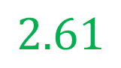
$$???$$
And works its way backwards to estimate all of the parameters
$$b$$
$$???$$
$$???$$
$${ x}_{i}$$
$$2.61$$
$$b$$
$$???$$
$$???$$
$$b$$
$$???$$
Input Layer
Hidden Layer
Output Layer

Slide 16
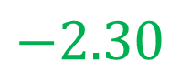
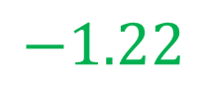
$$???$$
And works its way backwards to estimate all of the parameters
$$b$$
$$???$$
$$−1.22$$
$${ x}_{i}$$
$$2.61$$
$$b$$
$$???$$
$$−2.30$$
$$b$$
$$???$$
Input Layer
Hidden Layer
Output Layer

Slide 17
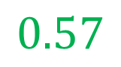
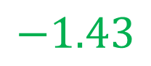
$$−1.43$$
And works its way backwards to estimate all of the parameters
$$b$$
$$???$$
$$−1.22$$
$${ x}_{i}$$
$$2.61$$
$$b$$
$$???$$
$$−2.30$$
$$b$$
$$0.57$$
Input Layer
Hidden Layer
Output Layer

Slide 18
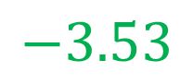
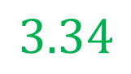
$$−1.43$$
And works its way backwards to estimate all of the parameters
$$b$$
$$3.34$$
$$−1.22$$
$${ x}_{i}$$
$$2.61$$
$$b$$
$$−3.53$$
$$−2.30$$
$$b$$
$$0.57$$
Input Layer
Hidden Layer
Output Layer

Slide 19
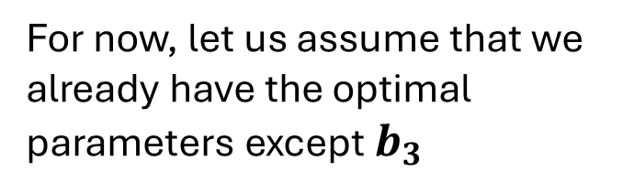
$$−1.43$$
For now, let us assume that we already have the optimal parameters except $b_{3}$
$$b$$
$$3.34$$
$$−1.22$$
$${ x}_{i}$$
$$???$$
$$b$$
$$−3.53$$
$$−2.30$$
$$b$$
$$0.57$$
Input Layer
Hidden Layer
Output Layer

Slide 20
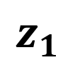
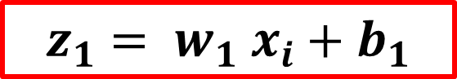
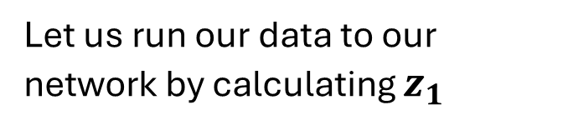
$$−1.43$$
Let us run our data to our network by calculating $z_{1}$
$$b$$
Softplus
$$z_{1}$$
$$3.34$$
$$−1.22$$
$${ x}_{i}$$
$$???$$
$$b$$
$$−3.53$$
$$−2.30$$
$$b$$
$$z_{1}= w_{1} x_{i}+b_{1}$$
$$0.57$$
Input Layer
Hidden Layer
Output Layer

Slide 21
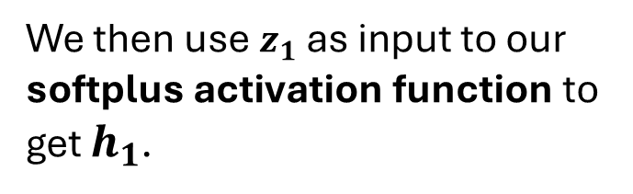
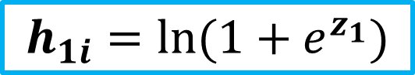


$$−1.43$$
We then use $z_{1}$ as input to our softplus activation function to get $h_{1}$.
$$b$$
Softplus
$$h_{1i}$$
$$z_{1}$$
$$3.34$$
$$−1.22$$
$${ x}_{i}$$
$$???$$
$$b$$
$$−3.53$$
$$−2.30$$
$$b$$
$$z_{1}= w_{1} x_{i}+b_{1}$$
$$0.57$$
$$h_{1i}=\ln{(1+e^{z_{1}})}$$
Input Layer
Hidden Layer
Output Layer

Slide 22

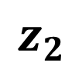
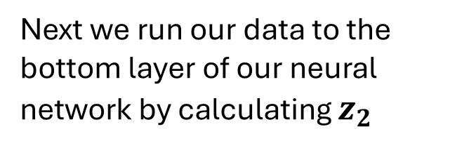
$$−1.43$$
Next we run our data to the bottom layer of our neural network by calculating $z_{2}$
$$b$$
Softplus
$$h_{1i}$$
$$z_{1}$$
$$3.34$$
$$−1.22$$
$${ x}_{i}$$
$$???$$
$$b$$
$$−3.53$$
$$−2.30$$
$$b$$
Softplus
$$z_{2}= w_{2} x_{i}+b_{2}$$
$$z_{2}$$
$$0.57$$
Input Layer
Hidden Layer
Output Layer

Slide 23
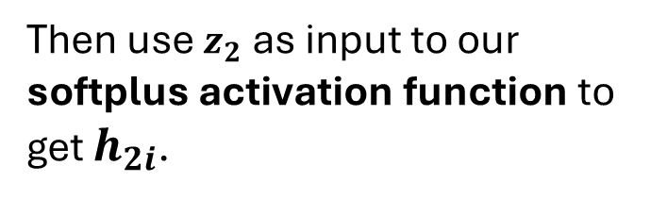


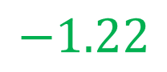

$$−1.43$$
Then use $z_{2}$ as input to our softplus activation function to get $h_{2i}$.
$$b$$
Softplus
$$h_{1i}$$
$$z_{1}$$
$$3.34$$
$$−1.22$$
$${ x}_{i}$$
$$???$$
$$b$$
$$−3.53$$
$$−2.30$$
$$b$$
Softplus
$$h_{2i}$$
$$z_{2}= w_{2} x_{i}+b_{2}$$
$$z_{2}$$
$$0.57$$
$$h_{2i}=\ln{(1+e^{z_{2}})}$$
Input Layer
Hidden Layer
Output Layer

Slide 24
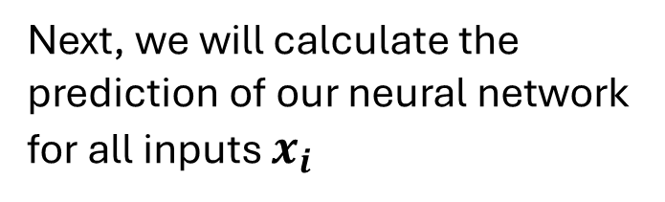
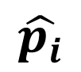
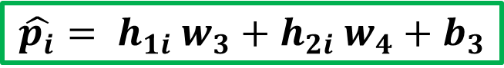
$$−1.43$$
Next, we will calculate the prediction of our neural network for all inputs $x_{i}$
$$b$$
Softplus
$$h_{1i}$$
$$z_{1}$$
$$3.34$$
$$−1.22$$
$${ x}_{i}$$
$$???$$
$$b$$
$$\hat{p_{i}}$$
$$−3.53$$
$$−2.30$$
$$b$$
Softplus
$$h_{2i}$$
$$z_{2}$$
$$\hat{p_{i}}= h_{1i} w_{3}+h_{2i} w_{4}+b_{3}$$
$$0.57$$
Input Layer
Hidden Layer
Output Layer

Slide 25

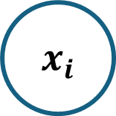
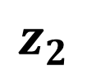
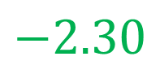

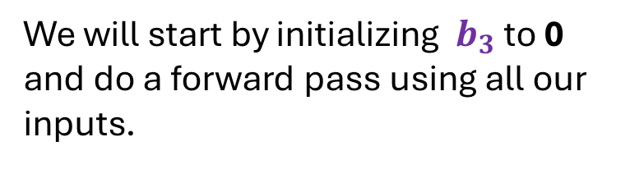
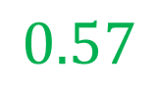

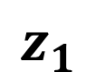
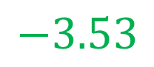

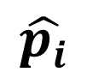
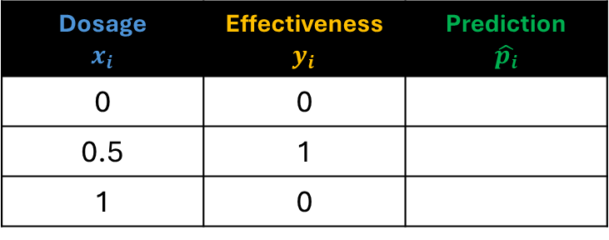
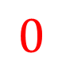
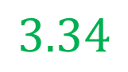
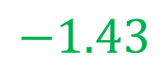


Dosage $$x_{i}$$ | Effectiveness $y_{i}$ | Prediction $$\hat{p_{i}}$$
0 | 0
0.5 | 1
1 | 0
$$−1.43$$
$$b$$
Softplus
$$h_{1i}$$
$$z_{1}$$
$$3.34$$
$$−1.22$$
$${ x}_{i}$$
$$0$$
$$b$$
$$\hat{p_{i}}$$
$$−3.53$$
$$−2.30$$
We will start by initializing $b_{3}$ to 0 and do a forward pass using all our inputs.
$$b$$
Softplus
$$h_{2i}$$
$$z_{2}$$
$$0.57$$

Slide 26

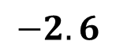

Dosage $$x_{i}$$ | Effectiveness $y_{i}$ | Prediction $$\hat{p_{i}}$$
0 | 0 | -2.6
0.5 | 1
1 | 0
$$−1.43$$
$$b$$
Softplus
$$h_{1i}$$
$$z_{1}$$
$$3.34$$
$$−1.22$$
$$0$$
$$0$$
$$b$$
$$−2.6$$
$$−3.53$$
$$−2.30$$
For our first forward pass, we get -2.6
$$b$$
Softplus
$$h_{2i}$$
$$z_{2}$$
$$0.57$$

Slide 27
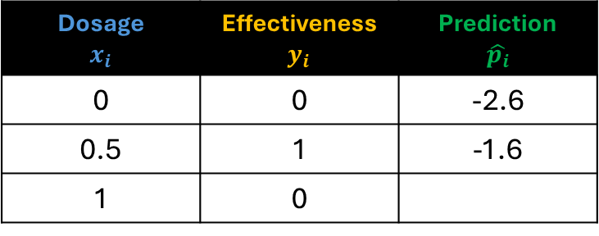
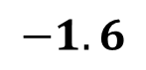

Dosage $$x_{i}$$ | Effectiveness $y_{i}$ | Prediction $$\hat{p_{i}}$$
0 | 0 | -2.6
0.5 | 1 | -1.6
1 | 0
$$−1.43$$
$$b$$
Softplus
$$h_{1i}$$
$$z_{1}$$
$$3.34$$
$$−1.22$$
$$0.5$$
$$0$$
$$b$$
$$−1.6$$
$$−3.53$$
$$−2.30$$
For our second forward pass, we get -1.6
$$b$$
Softplus
$$h_{2i}$$
$$z_{2}$$
$$0.57$$

Slide 28
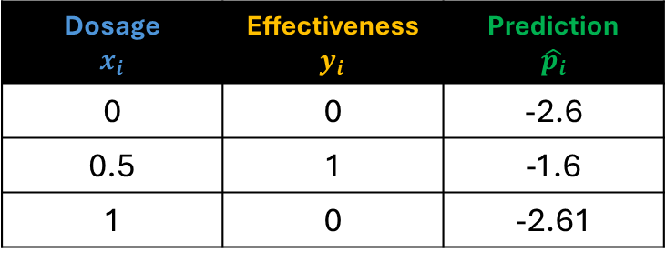
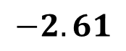

Dosage $$x_{i}$$ | Effectiveness $y_{i}$ | Prediction $$\hat{p_{i}}$$
0 | 0 | -2.6
0.5 | 1 | -1.6
1 | 0 | -2.61
$$−1.43$$
$$b$$
Softplus
$$h_{1i}$$
$$z_{1}$$
$$3.34$$
$$−1.22$$
$$1$$
$$0$$
$$b$$
$$−2.61$$
$$−3.53$$
$$−2.30$$
And for the third forward pass, we get -2.61
$$b$$
Softplus
$$h_{2i}$$
$$z_{2}$$
$$0.57$$

Slide 29
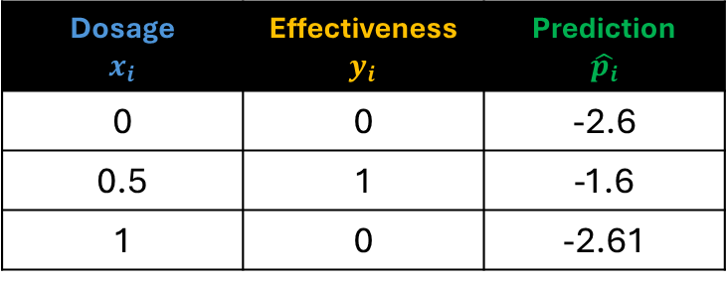
Dosage $$x_{i}$$ | Effectiveness $y_{i}$ | Prediction $$\hat{p_{i}}$$
0 | 0 | -2.6
0.5 | 1 | -1.6
1 | 0 | -2.61
$$−1.43$$
$$b$$
Softplus
$$h_{1i}$$
$$z_{1}$$
$$3.34$$
$$−1.22$$
$${ x}_{i}$$
$$0$$
Loss function
$$b$$
$$\hat{p_{i}}$$
$$−3.53$$
$$−2.30$$
Next, we will compute the total loss. In our example we will use the Sum of Squared Error loss function.
$$b$$
Softplus
$$h_{2i}$$
$$z_{2}$$
$$0.57$$

Slide 30
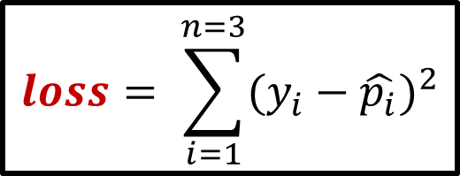
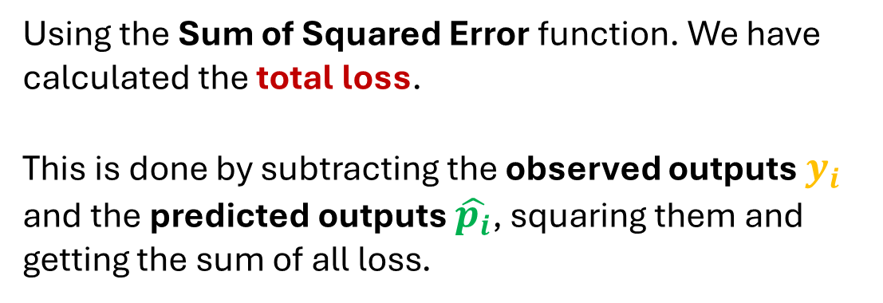


Using the Sum of Squared Error function. We have calculated the total loss.
This is done by subtracting the observed outputs $y_{i}$ and the predicted outputs $\hat{p_{i}}$, squaring them and getting the sum of all loss.
Dosage $$x_{i}$$ | Effectiveness $y_{i}$ | Prediction $$\hat{p_{i}}$$
0 | 0 | -2.6
0.5 | 1 | -1.6
1 | 0 | -2.61
$$loss= \sum_{i=1}^{n=3}{{(y_{i}−\hat{p_{i}})}^{2}}$$
$$loss={(0−(−2.6))}^{2}$$
$$\text{+ }{(1−(−1.6))}^{2}$$
$$+{(0−(−2.61))}^{2}$$
$$loss=20.331$$

Slide 31



Loss
20.331
$$b_{3}$$
Let us use a graph to keep track of the loss.
So when we set $b_{3}$ to 0 the loss is 20.331

Slide 32
Loss
20.331
$$b_{3}$$
And that corresponds to this location in this graph that has the loss on the y-axis and the bias on the x-axis

Slide 33

Loss
7.8
$$b_{3}$$
If we increase $b_{3}$ to 1 we get, a loss of 7.8

Slide 34

Loss
1.11
$$b_{3}$$
If we increase $b_{3}$ to 2 we get, a loss of 1.11

Slide 35

Loss
0.46
$$b_{3}$$
If we increase $b_{3}$ to 3 we get, a loss of 0.46

Slide 36


Loss
0.46
$$b_{3}$$
If we had time and manually plug in tons of values for $b_{3}$, we get this curve and we could find the lowest point where the loss is the lowest.

Slide 37
Loss
0.46
$$b_{3}$$
Instead of doing that, we will use Gradient Descent to find it relatively quickly.

Slide 38


$$\frac{d loss}{{d b}_{3}}$$
Loss
$$b_{3}$$
And that means we will need to find the derivative of the Loss with respect to $b_{3}$

Slide 39

$$\frac{d loss}{{d b}_{3}}$$
Loss
$$b_{3}$$
In order to find the derivative, we must first find out if there is a connection between Loss and $b_{3}$

Slide 40

$$loss= \sum_{i=1}^{n=3}{{(y_{i}−\hat{p_{i}})}^{2}}$$
Loss
$$b_{3}$$
Remember the loss function we used to calculate the total loss?

Slide 41

$$loss= \sum_{i=1}^{n=3}{{(y_{i}−\hat{p_{i}})}^{2}}$$
Loss
$$b_{3}$$
When we calculated the total loss, remember that we subtracted the observed values $y_{i}$ and the predicted values $\hat{p_{i}}$

Slide 42

$$loss= \sum_{i=1}^{n=3}{{(y_{i}−\hat{p_{i}})}^{2}}$$
Loss
$$b_{3}$$
Now let us talk about a little bit more about the predicted values $\hat{p_{i}}$

Slide 43


$$loss= \sum_{i=1}^{n=3}{{(y_{i}−\hat{p_{i}})}^{2}}$$
Loss
$$\hat{p_{i}}= h_{1i} w_{3}+h_{2} w_{4}+b_{3}$$
$$b_{3}$$
Remember that each predicted value $\hat{p_{i}}$ is the sum of ${ h}_{1i} × w_{3} and h_{2i }×w_{4}$ plus $b_{3}$

Slide 44



$$loss= \sum_{i=1}^{n=3}{{(y_{i}−\hat{p_{i}})}^{2}}$$
Loss
$$\hat{p_{i}}= h_{1i} w_{3}+h_{2} w_{4}+b_{3}$$
$$b_{3}$$
We can see that Loss and $b_{3}$ are linked or connected by the predicted values $\hat{p_{i}}$

Slide 45


$$loss= \sum_{i=1}^{n=3}{{(y_{i}−\hat{p_{i}})}^{2}}$$
$$\hat{p_{i}}= h_{1i} w_{3}+h_{2i} w_{4}+b_{3}$$
And because Loss and $b_{3}$ are linked or connected by the predicted values $\hat{p_{i}}$…

Slide 46


$$\frac{d loss}{{d b}_{3}}$$
We can use The Chain Rule to solve for the derivative of $loss$ with respect to $b_{3}$.

Slide 47


$$\frac{d loss}{{d b}_{3}}$$
The Chain Rule says that the derivative of the $loss$ with respect to $b_{3}$

Slide 48



$$\frac{d loss}{{d b}_{3}}$$
$$=\frac{d loss}{d \hat{p_{i}}}$$
$$×\frac{d \hat{p_{i}}}{{d b}_{3}}$$
Is the derivative of the $loss$ with respect to the predicted values $\hat{p_{i}}$times the derivative of the predicted values $\hat{p_{i}}$ with respect to $b_{3}$

Slide 49




$$\frac{d loss}{{d b}_{3}}$$
$$=\frac{d loss}{d \hat{p_{i}}}$$
$$×\frac{d \hat{p_{i}}}{{d b}_{3}}$$
Let us do this step by step and solve for the derivative of $loss$ with respect to the predicted values $\hat{p_{i}}$

Slide 50






$$\frac{d loss}{{d b}_{3}}$$
$$=\frac{d loss}{d \hat{p_{i}}}$$
$$×\frac{d \hat{p_{i}}}{{d b}_{3}}$$
$$loss= \sum_{i=1}^{n=3}{{(y_{i}−\hat{p_{i}})}^{2}}$$
1. Using the loss function,
$$\frac{d }{d \hat{p_{i}}}\sum_{i=1}^{n=3}{{(y_{i}−\hat{p_{i}})}^{2}}$$
substitute the equation
$$\frac{d loss}{d \hat{p_{i}}}$$
to

Slide 51



$$\frac{d loss}{{d b}_{3}}$$
$$=\frac{d loss}{d \hat{p_{i}}}$$
$$×\frac{d \hat{p_{i}}}{{d b}_{3}}$$
$$\frac{d }{d \hat{p_{i}}}\sum_{i=1}^{n=3}{{(y_{i}−\hat{p_{i}})}^{2}}$$
2. Get the derivative of
If we use the power rule, we get…
$$\frac{d }{d \hat{p_{i}}}\sum_{i=1}^{n=3}{{(y_{i}−\hat{p_{i}})}^{2}}=\sum_{i=1}^{n=3}{{2(y_{i}−\hat{p_{i}})}^{2−1}}×−1$$
$$\frac{d }{d \hat{p_{i}}}\sum_{i=1}^{n=3}{{(y_{i}−\hat{p_{i}})}^{2}}=\sum_{i=1}^{n=3}{−2(y_{i}−\hat{p_{i}})}$$

Slide 52



$$\frac{d loss}{{d b}_{3}}$$
$$=\frac{d loss}{d \hat{p_{i}}}$$
$$×\frac{d \hat{p_{i}}}{{d b}_{3}}$$
$$\frac{d }{d \hat{p_{i}}}\sum_{i=1}^{n=3}{{(y_{i}−\hat{p_{i}})}^{2}}$$
3. Substitute back the equation
$$\frac{d loss}{d \hat{p_{i}}}$$
to
$$\frac{d loss}{d \hat{p_{i}}}=\sum_{i=1}^{n=3}{−2(y_{i}−\hat{p_{i}})}$$
We now have the derivative

Slide 53



$$\frac{d loss}{{d b}_{3}}$$
$$=\frac{d loss}{d \hat{p_{i}}}$$
$$×\frac{d \hat{p_{i}}}{{d b}_{3}}$$
Next, we get the derivative of the predicted outputs $\hat{p_{i}}$with respect to $b_{3}$

Slide 54





$$\frac{d loss}{{d b}_{3}}$$
$$=\frac{d loss}{d \hat{p_{i}}}$$
$$×\frac{d \hat{p_{i}}}{{d b}_{3}}$$
1. Using the formula to get the predicted values,
$$\hat{p_{i}}= h_{1i} w_{3}+h_{2i} w_{4}+b_{3}$$
$$\frac{d \hat{p_{i}}}{{d b}_{3}}$$
$$\frac{d }{{d b}_{3}}(h_{1i} w_{3}+h_{2i} w_{4}+b_{3})$$
substitute the equation
to

Slide 55



$$\frac{d loss}{{d b}_{3}}$$
$$=\frac{d loss}{d \hat{p_{i}}}$$
$$×\frac{d \hat{p_{i}}}{{d b}_{3}}$$
$$\frac{d }{{d b}_{3}}(h_{1i} w_{3}+h_{2i} w_{4}+b_{3})$$
2. Get the derivative of
Using the constant rule, we get..
$$\frac{d }{{d b}_{3}}\left(h_{1i} w_{3}+h_{2i} w_{4}+b_{3}\right)=0+0+1$$
$$\frac{d }{{d b}_{3}}\left(h_{1i} w_{3}+h_{2i} w_{4}+b_{3}\right)=1$$

Slide 56



$$\frac{d loss}{{d b}_{3}}$$
$$=\frac{d loss}{d \hat{p_{i}}}$$
$$×\frac{d \hat{p_{i}}}{{d b}_{3}}$$
$$\frac{d }{{d b}_{3}}(h_{1i} w_{3}+h_{2i} w_{4}+b_{3})$$
3. Substitute back the equation
$$\frac{d \hat{p_{i}}}{{d b}_{3}}$$
to
$$\frac{d \hat{p_{i}}}{{d b}_{3}}=1$$
We now have the derivative

Slide 57






$$\frac{d loss}{{d b}_{3}}$$
$$=\frac{d loss}{d \hat{p_{i}}}$$
$$×\frac{d \hat{p_{i}}}{{d b}_{3}}$$
$$\frac{d loss}{d \hat{p_{i}}}=\sum_{i=1}^{n=3}{−2(y_{i}−\hat{p_{i}})}$$
$$\frac{d \hat{p_{i}}}{{d b}_{3}}=1$$
$$\frac{d loss}{{d b}_{3}}=\sum_{i=1}^{n=3}{−2\left(y_{i}−\hat{p_{i}}\right)}×1$$
Now we have both derivatives, we can plug them in

Slide 58


$$\frac{d loss}{{d b}_{3}}$$
$$=\frac{d loss}{d \hat{p_{i}}}$$
$$×\frac{d \hat{p_{i}}}{{d b}_{3}}$$
$$\frac{d loss}{{d b}_{3}}=\sum_{i=1}^{n=3}{−2\left(y_{i}−\hat{p_{i}}\right)}×1$$
Finally, we now have the derivative of the $loss$ with respect to $b_{3}$

Slide 59


$$\frac{d loss}{{d b}_{3}}=\sum_{i=1}^{n=3}{−2\left(y_{i}−\hat{p_{i}}\right)}×1$$
Loss
$$b_{3}$$
And we can use this derivative into Gradient Descent to find the optimal value for $b_{3}$

Slide 60


$$\frac{d loss}{{d b}_{3}}=\sum_{i=1}^{n=3}{−2\left(y_{i}−\hat{p_{i}}\right)}×1$$
Dosage $$x_{i}$$ | Effectiveness $y_{i}$ | Prediction $$\hat{p_{i}}$$
0 | 0 | -2.6
0.5 | 1 | -1.6
1 | 0 | -2.61
Let us plug in the observed values and predicted values in our equation
$$\frac{d loss}{{d b}_{3}} =−2\left(0−\left(−2.6\right)\right)× 1+−2\left(1−\left(−1.6\right)\right)×1+−2\left(0−\left(−2.61\right)\right)× 1$$
And we get…
$$\frac{d loss}{{d b}_{3}} =−15.7$$

Slide 61




$$\frac{d loss}{{d b}_{3}} =−15.7$$
Loss
$$b_{3}$$
-15.7 corresponds to the slope when $b_{3}$ is 0

Slide 62





$$Step Size=Slope ×learningrate$$
Dosage $$x_{i}$$ | Effectiveness $y_{i}$ | Prediction $$\hat{p_{i}}$$
0 | 0 | -2.6
0.5 | 1 | -1.6
1 | 0 | -2.61
Next, we calculate the step size by plugging in the slope -15.7
$$Step Size=−15.7 ×0.1=−1.57$$
We now calculate the new value of $b_{3}$
$$New{ b}_{3}=Old{ b}_{3}−Step Size$$
We get
$$New{ b}_{3}=0−\left(−1.57\right)=1.57$$

Slide 63




Dosage $$x_{i}$$ | Effectiveness $y_{i}$ | Prediction $$\hat{p_{i}}$$
0 | 0
0.5 | 1
1 | 0
$$−1.43$$
$$b$$
Softplus
$$h_{1i}$$
$$z_{1}$$
$$3.34$$
$$−1.22$$
$$x_{i}$$
$$1.57$$
$$b$$
$$\hat{p_{i}}$$
$$−3.53$$
$$−2.30$$
We not put 1.57 as our new value for $b_{3}$.
$$b$$
Softplus
$$h_{2i}$$
$$z_{2}$$
$$0.57$$

Slide 64

Dosage $$x_{i}$$ | Effectiveness $y_{i}$ | Prediction $$\hat{p_{i}}$$
0 | 0
0.5 | 1
1 | 0
$$−1.43$$
$$b$$
Softplus
$$h_{1i}$$
$$z_{1}$$
$$3.34$$
$$−1.22$$
$$x_{i}$$
$$1.57$$
$$b$$
$$\hat{p_{i}}$$
$$−3.53$$
$$−2.30$$
Do the forward pass for each input $x_{i}$ to generate the new predicted values $\hat{p_{i}}$
$$b$$
Softplus
$$h_{2i}$$
$$z_{2}$$
$$0.57$$

Slide 65

Dosage $$x_{i}$$ | Effectiveness $y_{i}$ | Prediction $$\hat{p_{i}}$$
0 | 0 | -1.03
0.5 | 1 | -0.03
1 | 0 | -1.04
$$−1.43$$
$$b$$
Softplus
$$h_{1i}$$
$$z_{1}$$
$$3.34$$
$$−1.22$$
$$x_{i}$$
$$1.57$$
$$b$$
$$\hat{p_{i}}$$
$$−3.53$$
$$−2.30$$
Do the forward pass for each input $x_{i}$ to generate the new predicted values $\hat{p_{i}}$
$$b$$
Softplus
$$h_{2i}$$
$$z_{2}$$
$$0.57$$

Slide 66

$$\frac{d loss}{{d b}_{3}}=\sum_{i=1}^{n=3}{−2\left(y_{i}−\hat{p_{i}}\right)}×1$$
Dosage $$x_{i}$$ | Effectiveness $y_{i}$ | Prediction $$\hat{p_{i}}$$
0 | 0 | -1.03
0.5 | 1 | -0.03
1 | 0 | -1.04
If we plug in the observed values and predicted values in our equation
$$\frac{d loss}{{d b}_{3}} =−2\left(0−\left(−1.03\right)\right)× 1+−2\left(1−\left(−0.03\right)\right)×1+−2\left(0−\left(−1.04\right)\right)× 1$$
And we get…
$$\frac{d loss}{{d b}_{3}} =−6.26$$

Slide 67

$$\frac{d loss}{{d b}_{3}} =−6.26$$
Loss
$$b_{3}$$
-6.26 corresponds to the slope when $b_{3}$ is 1.57

Slide 68
$$Step Size=Slope ×learningrate$$
Dosage $$x_{i}$$ | Effectiveness $y_{i}$ | Prediction $$\hat{p_{i}}$$
0 | 0 | -1.03
0.5 | 1 | -0.03
1 | 0 | -1.04
Next, we calculate the step size by plugging in the slope -6.26
$$Step Size=−6.26 ×0.1=−0.626$$
We now calculate the new value of $b_{3}$
$$New{ b}_{3}=Old{ b}_{3}−Step Size$$
We get
$$New{ b}_{3}=1.57−\left(−0.626\right)=2.19$$

Slide 69



Dosage $$x_{i}$$ | Effectiveness $y_{i}$ | Prediction $$\hat{p_{i}}$$
0 | 0
0.5 | 1
1 | 0
$$−1.43$$
$$b$$
Softplus
$$h_{1}$$
$$z_{1}$$
$$3.34$$
$$−1.22$$
$$x_{i}$$
$$2.19$$
$$b$$
$$\hat{p_{i}}$$
$$−3.53$$
$$−2.30$$
Plugin the new value and this process repeats again and again and only stops if the Step Size is very close to 0
$$b$$
Softplus
$$h_{2}$$
$$z_{2}$$
$$0.57$$

Slide 70
Outline
What is Back Propagation?
Optimizing one parameter
Optimizing multiple parameters

Slide 71



$$−1.43$$
Let us now optimize all parameters at starting with $w_{3},w_{4}$.
$$b$$
Softplus
$$h_{1i}$$
$$z_{1}$$
$$3.34$$
$$???$$
$${ x}_{i}$$
$$???$$
$$b$$
$$\hat{p_{i}}$$
$$−3.53$$
$$???$$
$$b$$
Softplus
$$h_{2i}$$
$$z_{2}$$
$$0.57$$
Input Layer
Hidden Layer
Output Layer

Slide 72




$$−1.43$$
First we initialize $w_{3}$, $w_{4}$
with random values and set $b_{3}$to zero.
$$b$$
Softplus
$$h_{1i}$$
$$z_{1}$$
$$3.34$$
$$w_{3}$$
$$???$$
$$b_{3}$$
$${ x}_{i}$$
$$???$$
$$b$$
$$\hat{p_{i}}$$
$$−3.53$$
$$???$$
$$w_{4}$$
$$b$$
Softplus
$$h_{2i}$$
$$z_{2}$$
$$0.57$$
Input Layer
Hidden Layer
Output Layer

Slide 73



$$−1.43$$
First we initialize $w_{3}$, $w_{4}$
with random values and set $b_{3}$to zero.
$$b$$
Softplus
$$h_{1i}$$
$$z_{1}$$
$$3.34$$
$$0.36$$
$${ x}_{i}$$
$$0$$
$$b$$
$$\hat{p_{i}}$$
$$−3.53$$
$$0.63$$
$$b$$
Softplus
$$h_{2i}$$
$$z_{2}$$
$$0.57$$
Input Layer
Hidden Layer
Output Layer

Slide 74


$$loss= \sum_{i=1}^{n=3}{{(y_{i}−\hat{p_{i}})}^{2}}$$
$$\hat{p_{i}}= h_{1i} w_{3}+h_{2i} w_{4}+b_{3}$$
Because Loss and $w_{3}$ , and $w_{4}$ are also linked by the predicted values $\hat{p_{i}}$…

Slide 75




$$\frac{d loss}{{d w}_{3}}$$
$$=\frac{d loss}{d \hat{p_{i}}}$$
$$×\frac{d \hat{p_{i}}}{{d w}_{3}}$$
Is the derivative of the $loss$ with respect to the predicted values $\hat{p_{i}}$times the derivative of the predicted values $\hat{p_{i}}$ with respect to $w_{3}$

Slide 76



$$\frac{d loss}{{d w}_{4}}$$
$$=\frac{d loss}{d \hat{p_{i}}}$$
$$×\frac{d \hat{p_{i}}}{{d w}_{4}}$$
Is the derivative of the $loss$ with respect to the predicted values $\hat{p_{i}}$times the derivative of the predicted values $\hat{p_{i}}$ with respect to $w_{4}$

Slide 77







$$\frac{d loss}{{d w}_{3}}$$
$$=\frac{d loss}{d \hat{p_{i}}}$$
$$×\frac{d \hat{p_{i}}}{{d w}_{3}}$$
$$\frac{d loss}{{d w}_{4}}$$
$$=\frac{d loss}{d \hat{p_{i}}}$$
$$×\frac{d \hat{p_{i}}}{{d w}_{4}}$$
Note that we already know the derivative of the $loss$ with respect to the predicted values $\hat{p_{i}}$

Slide 78

$$\frac{d loss}{{d w}_{3}}$$
$$=\frac{d loss}{d \hat{p_{i}}}$$
$$×\frac{d \hat{p_{i}}}{{d w}_{3}}$$
$$\frac{d loss}{{d w}_{4}}$$
$$=\frac{d loss}{d \hat{p_{i}}}$$
$$×\frac{d \hat{p_{i}}}{{d w}_{4}}$$
We just need to find the derivative of the predicted values $\hat{p_{i}}$ with respect to $w_{3}$ and $w_{4}$

Slide 79






$$\frac{d loss}{{d w}_{3}}$$
$$=\frac{d loss}{d \hat{p_{i}}}$$
$$×\frac{d \hat{p_{i}}}{{d w}_{3}}$$
$$\frac{d loss}{{d w}_{4}}$$
$$=\frac{d loss}{d \hat{p_{i}}}$$
$$×\frac{d \hat{p_{i}}}{{d w}_{4}}$$
We just need to find the derivative of the predicted values $\hat{p_{i}}$ with respect to $w_{3}$ and $w_{4}$

Slide 80




$$\frac{d loss}{{d w}_{3}}$$
$$=\frac{d loss}{d \hat{p_{i}}}$$
$$×\frac{d \hat{p_{i}}}{{d w}_{3}}$$
1. Using the formula to get the predicted values,
$$\hat{p_{i}}= h_{1i} w_{3}+h_{2i} w_{4}+b_{3}$$
$$\frac{d \hat{p_{i}}}{{d w}_{3}}$$
$$\frac{d }{{d w}_{3}}(h_{1i} w_{3}+h_{2i} w_{4}+b_{3})$$
substitute the equation
to

Slide 81




$$\frac{d loss}{{d w}_{3}}$$
$$=\frac{d loss}{d \hat{p_{i}}}$$
$$×\frac{d \hat{p_{i}}}{{d w}_{3}}$$
$$\frac{d }{{d w}_{3}}(h_{1i} w_{3}+h_{2i} w_{4}+b_{3})$$
2. Get the derivative of
Using the constant rule, we get..
$$\frac{d }{{d w}_{3}}\left(h_{1i} w_{3}+h_{2i} w_{4}+b_{3}\right)=h_{1i}+0+0$$
$$\frac{d }{{d w}_{3}}\left(h_{1i} w_{3}+h_{2i} w_{4}+b_{3}\right)=h_{1i}$$

Slide 82



$$\frac{d loss}{{d w}_{3}}$$
$$=\frac{d loss}{d \hat{p_{i}}}$$
$$×\frac{d \hat{p_{i}}}{{d w}_{3}}$$
$$\frac{d }{{d w}_{3}}\left(h_{1i} w_{3}+h_{2i} w_{4}+b_{3}\right)$$
3. Substitute back the equation
$$\frac{d \hat{p_{i}}}{{d w}_{3}}$$
to
$$\frac{d \hat{p_{i}}}{{d w}_{3}}=h_{1i}$$
We now have the derivative

Slide 83




$$\frac{d loss}{{d w}_{4}}$$
$$=\frac{d loss}{d \hat{p_{i}}}$$
$$×\frac{d \hat{p_{i}}}{{d w}_{4}}$$
1. Using the formula to get the predicted values,
$$\hat{p_{i}}= h_{1i} w_{3}+h_{2i} w_{4}+b_{3}$$
$$\frac{d \hat{p_{i}}}{{d w}_{4}}$$
$$\frac{d }{{d w}_{4}}(h_{1i} w_{3}+h_{2i} w_{4}+b_{3})$$
substitute the equation
to

Slide 84




$$\frac{d loss}{{d w}_{4}}$$
$$=\frac{d loss}{d \hat{p_{i}}}$$
$$×\frac{d \hat{p_{i}}}{{d w}_{4}}$$
$$\frac{d }{{d w}_{4}}(h_{1i} w_{3}+h_{2i} w_{4}+b_{3})$$
2. Get the derivative of
Using the constant rule, we get..
$$\frac{d }{{d w}_{4}}\left(h_{1i} w_{3}+h_{2i} w_{4}+b_{3}\right)=0+h_{2i}+0$$
$$\frac{d }{{d w}_{4}}\left(h_{1i} w_{3}+h_{2i} w_{4}+b_{3}\right)=h_{2i}$$

Slide 85


$$\frac{d loss}{{d w}_{4}}$$
$$=\frac{d loss}{d \hat{p_{i}}}$$
$$×\frac{d \hat{p_{i}}}{{d w}_{4}}$$
$$\frac{d }{{d w}_{3}}\left(h_{1i} w_{3}+h_{2i} w_{4}+b_{3}\right)$$
3. Substitute back the equation
$$\frac{d \hat{p_{i}}}{{d w}_{4}}$$
to
$$\frac{d \hat{p_{i}}}{{d w}_{4}}=h_{2i}$$
We now have the derivative

Slide 86









$$\frac{d loss}{{d b}_{3}}=\sum_{i=1}^{n=3}{−2\left(y_{i}−\hat{p_{i}}\right)}×1$$
$$\frac{d \hat{p_{i}}}{{d w}_{3}}=h_{1i}$$
$$\frac{d \hat{p_{i}}}{{d w}_{4}}=h_{2i}$$
$$\frac{d loss}{{d w}_{3}}$$
$$=\frac{d loss}{d \hat{p_{i}}}$$
$$×\frac{d \hat{p_{i}}}{{d w}_{3}}$$
If we plug in the derivatives, we get…
$$\frac{d loss}{{d w}_{4}}$$
$$=\frac{d loss}{d \hat{p_{i}}}$$
$$×\frac{d \hat{p_{i}}}{{d w}_{4}}$$

Slide 87




$$\frac{d loss}{{d b}_{3}}=\sum_{i=1}^{n=3}{−2\left(y_{i}−\hat{p_{i}}\right)}×1$$
$$\frac{d loss}{{d w}_{3}}=\sum_{i=1}^{n=3}{−2\left(y_{i}−\hat{p_{i}}\right)}×1×h_{1i}$$
We now have the derivatives
of $\frac{d loss}{{d w}_{3}}$ and $\frac{d loss}{{d w}_{4}}$
$$\frac{d loss}{{d w}_{4}}==\sum_{i=1}^{n=3}{−2\left(y_{i}−\hat{p_{i}}\right)}×1×h_{2i}$$

Slide 88







$$b_{1}$$
$$???$$
Let us now optimize the remaining weights and biases $w_{1}$, $w_{2},b_{1},b_{2}$
$$w_{1}$$
$$b$$
Softplus
$$h_{1i}$$
$$z_{1}$$
$$???$$
$$w_{3}$$
$$???$$
$$b_{3}$$
$${ x}_{i}$$
$$???$$
$$b$$
$$\hat{p_{i}}$$
$$???$$
$$???$$
$$w_{2}$$
$$w_{4}$$
$$b$$
Softplus
$$h_{2i}$$
$$z_{2}$$
$$???$$
$$b_{2}$$
Input Layer
Hidden Layer
Output Layer

Slide 89




$$loss= \sum_{i=1}^{n=3}{{(y_{i}−\hat{p_{i}})}^{2}}$$
$$\hat{p_{i}}= h_{1i} w_{3}+h_{2i} w_{4}+b_{3}$$
$$h_{1i}=\ln{(1+e^{z_{1}})}$$
$$z_{1}= w_{1} x_{i}+b_{1}$$
Because Loss and $w_{1}$are linked by the predicted values $\hat{p_{i}},h_{1i}$ and $z_{1i}$…

Slide 90






$$\frac{d loss}{{d w}_{1}}$$
$$=\frac{d loss}{d \hat{p_{i}}}$$
$$×\frac{d \hat{p_{i}}}{{d h}_{1i}}$$
$$×\frac{{d h}_{1i}}{{d z}_{1i}}$$
$$×\frac{{d z}_{1i}}{{d w}_{1}}$$
This are the derivatives we need to multiply to get the derivate of loss with respect to $w_{1}$

Slide 91



$$\frac{d loss}{{d w}_{1}}$$
$$=\frac{d loss}{d \hat{p_{i}}}$$
$$×\frac{d \hat{p_{i}}}{{d h}_{1i}}$$
$$×\frac{{d h}_{1i}}{{d z}_{1i}}$$
$$×\frac{{d z}_{1i}}{{d w}_{1}}$$
We only have to get these derivatives because we already know $\frac{d loss}{d \hat{p_{i}}}$

Slide 92








$$\frac{d loss}{{d w}_{1}}$$
$$=\frac{d loss}{d \hat{p_{i}}}$$
$$×\frac{d \hat{p_{i}}}{{d h}_{1i}}$$
$$×\frac{{d h}_{1i}}{{d z}_{1i}}$$
$$×\frac{{d z}_{1i}}{{d w}_{1}}$$
1. Using the formula to get the predicted values,
$$\hat{p_{i}}= h_{1i} w_{3}+h_{2i} w_{4}+b_{3}$$
$$\frac{d \hat{p_{i}}}{{d h}_{1i}}$$
$$\frac{d }{{d h}_{1i}}(h_{1i} w_{3}+h_{2i} w_{4}+b_{3})$$
substitute the equation
to

Slide 93



$$\frac{d loss}{{d w}_{1}}$$
$$=\frac{d loss}{d \hat{p_{i}}}$$
$$×\frac{d \hat{p_{i}}}{{d h}_{1i}}$$
$$×\frac{{d h}_{1i}}{{d z}_{1i}}$$
$$×\frac{{d z}_{1i}}{{d w}_{1}}$$
$$\frac{d }{{d h}_{1i}}(h_{1i} w_{3}+h_{2i} w_{4}+b_{3})$$
2. Get the derivative of
Using the constant rule, we get..
$$\frac{d }{{d h}_{1i}}\left(h_{1i} w_{3}+h_{2i} w_{4}+b_{3}\right)=(1){(w}_{3})+0+0$$
$$\frac{d }{{d h}_{1i}}\left(h_{1i} w_{3}+h_{2i} w_{4}+b_{3}\right)=w_{3}$$

Slide 94



$$\frac{d loss}{{d w}_{1}}$$
$$=\frac{d loss}{d \hat{p_{i}}}$$
$$×\frac{d \hat{p_{i}}}{{d h}_{1i}}$$
$$×\frac{{d h}_{1i}}{{d z}_{1i}}$$
$$×\frac{{d z}_{1i}}{{d w}_{1}}$$
$$\frac{d }{{d h}_{1i}}\left(h_{1i} w_{3}+h_{2i} w_{4}+b_{3}\right)=w_{3}$$
3. Substitute back the equation
$$\frac{d \hat{p_{i}}}{{d h}_{1i}}$$
to
$$\frac{d \hat{p_{i}}}{{d h}_{1i}}=w_{3}$$
We now have the derivative

Slide 95





$$\frac{d loss}{{d w}_{1}}$$
$$=\frac{d loss}{d \hat{p_{i}}}$$
$$×\frac{d \hat{p_{i}}}{{d h}_{1i}}$$
$$×\frac{{d h}_{1i}}{{d z}_{1i}}$$
$$×\frac{{d z}_{1i}}{{d w}_{1}}$$
1. Using the formula to get the $h_{1i}$,
$$h_{1i}=\ln{(1+e^{z_{1i}})}$$
$$\frac{{d h}_{1i}}{{d z}_{1i}}$$
$$\frac{d}{{d z}_{1i}}\ln{(1+e^{z_{1i}})}$$
substitute the equation
to

Slide 96




$$\frac{d loss}{{d w}_{1}}$$
$$=\frac{d loss}{d \hat{p_{i}}}$$
$$×\frac{d \hat{p_{i}}}{{d h}_{1i}}$$
$$×\frac{{d h}_{1i}}{{d z}_{1i}}$$
$$×\frac{{d z}_{1i}}{{d w}_{1}}$$
$$\frac{d}{{d z}_{1i}}\ln{(1+e^{z_{1i}})}$$
2. Get the derivative by applying the chain rule
$$\frac{d}{d x}\ln\left(x\right)= \frac{1}{x}$$
And then use the rule on natural log
$$\frac{d}{d x}e^{x}=e^{x}$$
And exponential,
we get..
$$\frac{d}{{d z}_{1i}}\ln\left(1+e^{z_{1i}}\right)= \frac{1}{1+e^{z_{1i}}}×\left(1+e^{z_{1i}}\right)=\frac{e^{z_{1i}}}{1+e^{z_{1i}}}$$

Slide 97



$$\frac{d loss}{{d w}_{1}}$$
$$=\frac{d loss}{d \hat{p_{i}}}$$
$$×\frac{d \hat{p_{i}}}{{d h}_{1i}}$$
$$×\frac{{d h}_{1i}}{{d z}_{1i}}$$
$$×\frac{{d z}_{1i}}{{d w}_{1}}$$
$$\frac{d}{{d z}_{1i}}\ln\left(1+e^{z_{1i}}\right)= \frac{e^{z_{1i}}}{1+e^{z_{1i}}}$$
3. Substitute back the equation
$$\frac{{d h}_{1i}}{{d z}_{1i}}$$
to
$$\frac{{d h}_{1i}}{{d z}_{1i}}=\frac{e^{z_{1i}}}{1+e^{z_{1i}}}$$
We now have the derivative

Slide 98




$$\frac{d loss}{{d w}_{1}}$$
$$=\frac{d loss}{d \hat{p_{i}}}$$
$$×\frac{d \hat{p_{i}}}{{d h}_{1i}}$$
$$×\frac{{d h}_{1i}}{{d z}_{1i}}$$
$$×\frac{{d z}_{1i}}{{d w}_{1}}$$
1. Using the formula to get the $z_{1i}$,
$$z_{1i}= w_{1} x_{i}+b_{1}$$
$$\frac{{d z}_{1i}}{{d w}_{1}}$$
$$\frac{{d z}_{1i}}{{d w}_{1}}(w_{1} x_{i}+b_{1})$$
substitute the equation
to

Slide 99



$$\frac{d loss}{{d w}_{1}}$$
$$=\frac{d loss}{d \hat{p_{i}}}$$
$$×\frac{d \hat{p_{i}}}{{d h}_{1i}}$$
$$×\frac{{d h}_{1i}}{{d z}_{1i}}$$
$$×\frac{{d z}_{1i}}{{d w}_{1}}$$
$$\frac{{d z}_{1i}}{{d w}_{1}}(w_{1} x_{i}+b_{1})$$
2. Get the derivative of
Using the constant rule, we get..
$$\frac{{d z}_{1i}}{{d w}_{1}}(w_{1} x_{i}+b_{1})=x_{i}+0$$
$$\frac{{d z}_{1i}}{{d w}_{1}}(w_{1} x_{i}+b_{1})=x_{i}$$

Slide 100



$$\frac{d loss}{{d w}_{1}}$$
$$=\frac{d loss}{d \hat{p_{i}}}$$
$$×\frac{d \hat{p_{i}}}{{d h}_{1i}}$$
$$×\frac{{d h}_{1i}}{{d z}_{1i}}$$
$$×\frac{{d z}_{1i}}{{d w}_{1}}$$
$$\frac{{d z}_{1i}}{{d w}_{1}}(w_{1} x_{i}+b_{1})=x_{i}$$
3. Substitute back the equation
$$\frac{{d z}_{1i}}{{d w}_{1}}$$
to
$$\frac{{d z}_{1i}}{{d w}_{1}}=x_{i}$$
We now have the derivative

Slide 101







$$\frac{d loss}{{d w}_{1}}$$
$$=\frac{d loss}{d \hat{p_{i}}}$$
$$×\frac{d \hat{p_{i}}}{{d h}_{1i}}$$
$$×\frac{{d h}_{1i}}{{d z}_{1i}}$$
$$×\frac{{d z}_{1i}}{{d w}_{1}}$$
$$\frac{d loss}{d \hat{p_{i}}}=\sum_{i=1}^{n=3}{−2(y_{i}−\hat{p_{i}})}$$
$$\frac{d \hat{p_{i}}}{{d h}_{1i}}=w_{3}$$
$$\frac{{d h}_{1i}}{{d z}_{1i}}=\frac{e^{z_{1i}}}{1+e^{z_{1i}}}$$
$$\frac{{d z}_{1i}}{{d w}_{1}}=x_{i}$$
We now have the derivative for loss with respect to $w_{1}$
$$\frac{d loss}{{d w}_{1}}=\sum_{i=1}^{n=3}{−2\left(y_{i}−\hat{p_{i}}\right){×w}_{3} × \frac{e^{z_{1i}}}{1+e^{z_{1i}}}×x_{i}}$$

Slide 102





$$\frac{d loss}{{d b}_{3}}=\sum_{i=1}^{n=3}{−2\left(y_{i}−\hat{p_{i}}\right)}×1$$
$$\frac{d loss}{{d w}_{3}}=\sum_{i=1}^{n=3}{−2\left(y_{i}−\hat{p_{i}}\right)}×1×h_{1i}$$
$$\frac{d loss}{{d w}_{4}}=\sum_{i=1}^{n=3}{−2\left(y_{i}−\hat{p_{i}}\right)}×1×h_{2i}$$
We now have the derivative of $\frac{d loss}{{d w}_{1}}$
$$\frac{d loss}{{d w}_{1}}=\sum_{i=1}^{n=3}{−2\left(y_{i}−\hat{p_{i}}\right){×w}_{3} ×\frac{e^{z_{1i}}}{1+e^{z_{1i}}}×x_{i}}$$

Slide 103




$$\frac{d loss}{{d b}_{1}}$$
$$=\frac{d loss}{d \hat{p_{i}}}$$
$$×\frac{d \hat{p_{i}}}{{d h}_{1i}}$$
$$×\frac{{d h}_{1i}}{{d z}_{1i}}$$
$$×\frac{{d z}_{1i}}{{d b}_{1}}$$
Now we will get $\frac{d loss}{{d b}_{1}}$. It will be now be easier for us to get $b_{1}$ because its derivative is similar to $\frac{d loss}{{d w}_{1}}$

Slide 104
$$loss= \sum_{i=1}^{n=3}{{(y_{i}−\hat{p_{i}})}^{2}}$$
$$\hat{p_{i}}= h_{1i} w_{3}+h_{2i} w_{4}+b_{3}$$
$$h_{1i}=\ln{(1+e^{z_{1}})}$$
$$z_{1}= w_{1} x_{i}+b_{1}$$
Because Loss and $b_{1}$ are linked by $\hat{p_{i}},h_{2i}$ and $z_{1}$

Slide 105


$$\frac{d loss}{{d b}_{1}}$$
$$=\frac{d loss}{d \hat{p_{i}}}$$
$$×\frac{d \hat{p_{i}}}{{d h}_{1i}}$$
$$×\frac{{d h}_{1i}}{{d z}_{1i}}$$
$$×\frac{{d z}_{1i}}{{d b}_{1}}$$
We only have to get this derivative

Slide 106




$$\frac{d loss}{{d b}_{1}}$$
$$=\frac{d loss}{d \hat{p_{i}}}$$
$$×\frac{d \hat{p_{i}}}{{d h}_{1i}}$$
$$×\frac{{d h}_{1i}}{{d z}_{1i}}$$
$$×\frac{{d z}_{1i}}{{d b}_{1}}$$
1. Using the formula to get the $z_{1i}$,
$$z_{1i}= w_{1} x_{i}+b_{1}$$
$$\frac{{d z}_{1i}}{{d b}_{1}}$$
$$\frac{{d z}_{1i}}{{d b}_{1}}(w_{1} x_{i}+b_{1})$$
substitute the equation
to

Slide 107



$$\frac{d loss}{{d b}_{1}}$$
$$=\frac{d loss}{d \hat{p_{i}}}$$
$$×\frac{d \hat{p_{i}}}{{d h}_{1i}}$$
$$×\frac{{d h}_{1i}}{{d z}_{1i}}$$
$$×\frac{{d z}_{1i}}{{d b}_{1}}$$
$$\frac{{d z}_{1i}}{{d b}_{1}}(w_{1} x_{i}+b_{1})$$
2. Get the derivative of
Using the constant rule, we get..
$$\frac{{d z}_{1i}}{{d b}_{1}}(w_{1} x_{i}+b_{1})=0+1$$
$$\frac{{d z}_{1i}}{{d b}_{1}}(w_{1} x_{i}+b_{1})=1$$

Slide 108



$$\frac{d loss}{{d b}_{1}}$$
$$=\frac{d loss}{d \hat{p_{i}}}$$
$$×\frac{d \hat{p_{i}}}{{d h}_{1i}}$$
$$×\frac{{d h}_{1i}}{{d z}_{1i}}$$
$$×\frac{{d z}_{1i}}{{d b}_{1}}$$
$$\frac{{d z}_{1i}}{{d b}_{1}}(w_{1} x_{i}+b_{1})=1$$
3. Substitute back the equation
$$\frac{{d z}_{1i}}{{d b}_{1}}$$
to
$$\frac{{d z}_{1i}}{{d b}_{1}}=1$$
We now have the derivative

Slide 109



$$\frac{d loss}{{d b}_{1}}$$
$$=\frac{d loss}{d \hat{p_{i}}}$$
$$×\frac{d \hat{p_{i}}}{{d h}_{1i}}$$
$$×\frac{{d h}_{1i}}{{d z}_{1i}}$$
$$×\frac{{d z}_{1i}}{{d b}_{1}}$$
$$\frac{d loss}{d \hat{p_{i}}}=\sum_{i=1}^{n=3}{−2(y_{i}−\hat{p_{i}})}$$
$$\frac{d \hat{p_{i}}}{{d h}_{1i}}=w_{3}$$
$$\frac{{d h}_{1i}}{{d z}_{1i}}=\frac{e^{z_{1i}}}{1+e^{z_{1i}}}$$
$$\frac{{d z}_{1i}}{{d b}_{1}}=1$$
We now have the derivative for loss with respect to $b_{1}$
$$\frac{d loss}{{d b}_{1}}=\sum_{i=1}^{n=3}{−2\left(y_{i}−\hat{p_{i}}\right){×w}_{3} ×\frac{e^{z_{1i}}}{1+e^{z_{1i}}}×1}$$

Slide 110





$$\frac{d loss}{{d b}_{3}}=\sum_{i=1}^{n=3}{−2\left(y_{i}−\hat{p_{i}}\right)}×1$$
$$\frac{d loss}{{d w}_{3}}=\sum_{i=1}^{n=3}{−2\left(y_{i}−\hat{p_{i}}\right)}×1×h_{1i}$$
$$\frac{d loss}{{d b}_{1}}=\sum_{i=1}^{n=3}{−2\left(y_{i}−\hat{p_{i}}\right){×w}_{3} ×\frac{e^{z_{1i}}}{1+e^{z_{1i}}}×1}$$
$$\frac{d loss}{{d w}_{4}}=\sum_{i=1}^{n=3}{−2\left(y_{i}−\hat{p_{i}}\right)}×1×h_{2i}$$
$$\frac{d loss}{{d w}_{1}}=\sum_{i=1}^{n=3}{−2\left(y_{i}−\hat{p_{i}}\right){×w}_{3} ×\frac{e^{z_{1i}}}{1+e^{z_{1i}}}×x_{i}}$$

Slide 111




$$\frac{d loss}{{d w}_{2}}$$
$$=\frac{d loss}{d \hat{p_{i}}}$$
$$×\frac{d \hat{p_{i}}}{{d h}_{2i}}$$
$$×\frac{{d h}_{2i}}{{d z}_{2i}}$$
$$×\frac{{d z}_{2i}}{{d w}_{2}}$$
This is the derivate of the loss with respect to $w_{2}$

Slide 112



$$loss= \sum_{i=1}^{n=3}{{(y_{i}−\hat{p_{i}})}^{2}}$$
$$\hat{p_{i}}= h_{1i} w_{3}+h_{2i} w_{4}+b_{3}$$
$$h_{2i}=\ln{(1+e^{z_{2i}})}$$
$$z_{2i}= w_{1} x_{i}+b_{1}$$
Because Loss and $w_{2}$ are linked by $\hat{p_{i}},h_{2i}$ and $z_{2i}$

Slide 113






$$\frac{d loss}{{d w}_{2}}$$
$$=\frac{d loss}{d \hat{p_{i}}}$$
$$×\frac{d \hat{p_{i}}}{{d h}_{2i}}$$
$$×\frac{{d h}_{2i}}{{d z}_{2i}}$$
$$×\frac{{d z}_{2i}}{{d w}_{2}}$$
1. Using the formula to get the predicted values,
$$\hat{p_{i}}= h_{1i} w_{3}+h_{2i} w_{4}+b_{3}$$
$$\frac{d \hat{p_{i}}}{{d h}_{2i}}$$
$$\frac{d }{{d h}_{2i}}(h_{1i} w_{3}+h_{2i} w_{4}+b_{3})$$
substitute the equation
to

Slide 114



$$\frac{d loss}{{d w}_{2}}$$
$$=\frac{d loss}{d \hat{p_{i}}}$$
$$×\frac{d \hat{p_{i}}}{{d h}_{2i}}$$
$$×\frac{{d h}_{2i}}{{d z}_{2i}}$$
$$×\frac{{d z}_{2i}}{{d w}_{2}}$$
$$\frac{d }{{d h}_{2i}}(h_{1i} w_{3}+h_{2i} w_{4}+b_{3})$$
2. Get the derivative of
Using the constant rule, we get..
$$\frac{d }{{d h}_{2i}}\left(h_{1i} w_{3}+h_{2i} w_{4}+b_{3}\right)=0+(1){ (w}_{4})+0$$
$$\frac{d }{{d h}_{2i}}\left(h_{1i} w_{3}+h_{2i} w_{4}+b_{3}\right)=w_{4}$$

Slide 115



$$\frac{d loss}{{d w}_{2}}$$
$$=\frac{d loss}{d \hat{p_{i}}}$$
$$×\frac{d \hat{p_{i}}}{{d h}_{2i}}$$
$$×\frac{{d h}_{2i}}{{d z}_{2i}}$$
$$×\frac{{d z}_{2i}}{{d w}_{2}}$$
$$\frac{d }{{d h}_{2i}}\left(h_{1i} w_{3}+h_{2i} w_{4}+b_{3}\right)=w_{4}$$
3. Substitute back the equation
$$\frac{d \hat{p_{i}}}{{d h}_{2i}}$$
to
$$\frac{d \hat{p_{i}}}{{d h}_{2i}}=w_{4}$$
We now have the derivative

Slide 116







$$\frac{d loss}{{d w}_{2}}$$
$$=\frac{d loss}{d \hat{p_{i}}}$$
$$×\frac{d \hat{p_{i}}}{{d h}_{2i}}$$
$$×\frac{{d h}_{2i}}{{d z}_{2i}}$$
$$×\frac{{d z}_{2i}}{{d w}_{2}}$$
1. Using the formula to get the $h_{1i}$,
$$h_{2i}=\ln{(1+e^{z_{1i}})}$$
$$\frac{{d h}_{2i}}{{d z}_{2i}}$$
$$\frac{d}{{d z}_{2i}}\ln{(1+e^{z_{2i}})}$$
substitute the equation
to

Slide 117


$$\frac{d loss}{{d w}_{2}}$$
$$=\frac{d loss}{d \hat{p_{i}}}$$
$$×\frac{d \hat{p_{i}}}{{d h}_{2i}}$$
$$×\frac{{d h}_{2i}}{{d z}_{2i}}$$
$$×\frac{{d z}_{2i}}{{d w}_{2}}$$
$$\frac{d}{{d z}_{2i}}\ln{(1+e^{z_{2i}})}$$
2. Get the derivative by applying the chain rule
$$\frac{d}{d x}\ln\left(x\right)= \frac{1}{x}$$
And then use the rule on natural log
$$\frac{d}{d x}e^{x}=e^{x}$$
And exponential,
we get..
$$\frac{d}{{d z}_{2i}}\ln\left(1+e^{z_{2i}}\right)= \frac{1}{1+e^{z_{2i}}}×\left(1+e^{z_{2i}}\right)=\frac{e^{z_{2i}}}{1+e^{z_{2i}}}$$

Slide 118



$$\frac{d loss}{{d w}_{2}}$$
$$=\frac{d loss}{d \hat{p_{i}}}$$
$$×\frac{d \hat{p_{i}}}{{d h}_{2i}}$$
$$×\frac{{d h}_{2i}}{{d z}_{2i}}$$
$$×\frac{{d z}_{2i}}{{d w}_{2}}$$
$$\frac{d}{{d z}_{2i}}\ln\left(1+e^{z_{2i}}\right)= \frac{e^{z_{2i}}}{1+e^{z_{2i}}}$$
3. Substitute back the equation
$$\frac{{d h}_{2i}}{{d z}_{2i}}$$
to
$$\frac{{d h}_{2i}}{{d z}_{2i}}=\frac{e^{z_{2i}}}{1+e^{z_{2i}}}$$
We now have the derivative

Slide 119





$$\frac{d loss}{{d w}_{2}}$$
$$=\frac{d loss}{d \hat{p_{i}}}$$
$$×\frac{d \hat{p_{i}}}{{d h}_{2i}}$$
$$×\frac{{d h}_{2i}}{{d z}_{2i}}$$
$$×\frac{{d z}_{2i}}{{d w}_{2}}$$
1. Using the formula to get the $z_{1i}$,
$$z_{2i}= w_{2} x_{i}+b_{2i}$$
$$\frac{{d z}_{2i}}{{d w}_{2}}$$
$$\frac{{d z}_{2i}}{{d w}_{2}}(w_{2} x_{i}+b_{2i})$$
substitute the equation
to

Slide 120



$$\frac{d loss}{{d w}_{2}}$$
$$=\frac{d loss}{d \hat{p_{i}}}$$
$$×\frac{d \hat{p_{i}}}{{d h}_{2i}}$$
$$×\frac{{d h}_{2i}}{{d z}_{2i}}$$
$$×\frac{{d z}_{2i}}{{d w}_{2}}$$
$$\frac{{d z}_{2i}}{{d w}_{2}}(w_{2} x_{i}+b_{2i})$$
2. Get the derivative of
Using the constant rule, we get..
$$\frac{{d z}_{2i}}{{d w}_{2}}(w_{2} x_{i}+b_{2i})={1(x}_{i})+0$$
$$\frac{{d z}_{2i}}{{d w}_{2}}(w_{2} x_{i}+b_{2i})=x_{i}$$

Slide 121



$$\frac{d loss}{{d w}_{2}}$$
$$=\frac{d loss}{d \hat{p_{i}}}$$
$$×\frac{d \hat{p_{i}}}{{d h}_{2i}}$$
$$×\frac{{d h}_{2i}}{{d z}_{2i}}$$
$$×\frac{{d z}_{2i}}{{d w}_{2}}$$
$$\frac{{d z}_{2i}}{{d w}_{2}}(w_{2} x_{i}+b_{2i})=x_{i}$$
3. Substitute back the equation
$$\frac{{d z}_{2i}}{{d w}_{2}}$$
to
$$\frac{{d z}_{2i}}{{d w}_{2}}=x_{i}$$
We now have the derivative

Slide 122






$$\frac{d loss}{{d w}_{2}}$$
$$=\frac{d loss}{d \hat{p_{i}}}$$
$$×\frac{d \hat{p_{i}}}{{d h}_{2i}}$$
$$×\frac{{d h}_{2i}}{{d z}_{2i}}$$
$$×\frac{{d z}_{1i}}{{d w}_{2}}$$
$$\frac{d loss}{d \hat{p_{i}}}=\sum_{i=1}^{n=3}{−2(y_{i}−\hat{p_{i}})}$$
$$\frac{d \hat{p_{i}}}{{d h}_{2i}}=w_{4}$$
$$\frac{{d h}_{2i}}{{d z}_{2i}}=\frac{e^{z_{2i}}}{1+e^{z_{2i}}}$$
$$\frac{{d z}_{2i}}{{d w}_{2}}=x_{i}$$
We now have the derivative for loss with respect to $w_{2}$
$$\frac{d loss}{{d w}_{2}}=\sum_{i=1}^{n=3}{−2\left(y_{i}−\hat{p_{i}}\right){×w}_{4} × \frac{e^{z_{2i}}}{1+e^{z_{2i}}}×x_{i}}$$

Slide 123

$$\frac{d loss}{{d b}_{3}}=\sum_{i=1}^{n=3}{−2\left(y_{i}−\hat{p_{i}}\right)}×1$$
$$\frac{d loss}{{d w}_{3}}=\sum_{i=1}^{n=3}{−2\left(y_{i}−\hat{p_{i}}\right)}×1×h_{1i}$$
$$\frac{d loss}{{d b}_{1}}=\sum_{i=1}^{n=3}{−2\left(y_{i}−\hat{p_{i}}\right){×w}_{3} ×\frac{e^{z_{1i}}}{1+e^{z_{1i}}}×1}$$
$$\frac{d loss}{{d w}_{4}}=\sum_{i=1}^{n=3}{−2\left(y_{i}−\hat{p_{i}}\right)}×1×h_{2i}$$
$$\frac{d loss}{{d w}_{1}}=\sum_{i=1}^{n=3}{−2\left(y_{i}−\hat{p_{i}}\right){×w}_{3} ×\frac{e^{z_{1i}}}{1+e^{z_{1i}}}×x_{i}}$$
$$\frac{d loss}{{d w}_{2}}=\sum_{i=1}^{n=3}{−2\left(y_{i}−\hat{p_{i}}\right){×w}_{4} × \frac{e^{z_{2i}}}{1+e^{z_{2i}}}×x_{i}}$$

Slide 124


$$\frac{d loss}{{d b}_{2}}$$
$$=\frac{d loss}{d \hat{p_{i}}}$$
$$×\frac{d \hat{p_{i}}}{{d h}_{2i}}$$
$$×\frac{{d h}_{2i}}{{d z}_{2i}}$$
$$×\frac{{d z}_{2i}}{{d b}_{2}}$$
It will be now be easier for us to get $b_{2}$because its derivative is similar to $\frac{d loss}{{d w}_{2}}$

Slide 125

$$loss= \sum_{i=1}^{n=3}{{(y_{i}−\hat{p_{i}})}^{2}}$$
$$\hat{p_{i}}= h_{1i} w_{3}+h_{2i} w_{4}+b_{3}$$
$$h_{2i}=\ln{(1+e^{z_{2i}})}$$
$$z_{2i}= w_{1} x_{i}+b_{2}$$
Because Loss and $w_{2}$ are linked by $\hat{p_{i}},h_{2i}$ and $z_{2i}$

Slide 126


$$\frac{d loss}{{d b}_{2}}$$
$$=\frac{d loss}{d \hat{p_{i}}}$$
$$×\frac{d \hat{p_{i}}}{{d h}_{2i}}$$
$$×\frac{{d h}_{2i}}{{d z}_{2i}}$$
$$×\frac{{d z}_{2i}}{{d b}_{2}}$$
We only have to get this derivative

Slide 127





$$\frac{d loss}{{d b}_{2}}$$
$$=\frac{d loss}{d \hat{p_{i}}}$$
$$×\frac{d \hat{p_{i}}}{{d h}_{2i}}$$
$$×\frac{{d h}_{2i}}{{d z}_{2i}}$$
$$×\frac{{d z}_{2i}}{{d b}_{2}}$$
1. Using the formula to get the $z_{1i}$,
$$z_{2i}= w_{2} x_{i}+b_{2}$$
$$\frac{{d z}_{1i}}{{d b}_{2}}$$
$$\frac{{d z}_{2i}}{{d b}_{2}}(w_{2} x_{i}+b_{2})$$
substitute the equation
to

Slide 128



$$\frac{d loss}{{d b}_{2}}$$
$$=\frac{d loss}{d \hat{p_{i}}}$$
$$×\frac{d \hat{p_{i}}}{{d h}_{2i}}$$
$$×\frac{{d h}_{2i}}{{d z}_{2i}}$$
$$×\frac{{d z}_{2i}}{{d b}_{2}}$$
$$\frac{{d z}_{2i}}{{d b}_{2}}(w_{2} x_{i}+b_{2})$$
2. Get the derivative of
Using the constant rule, we get..
$$\frac{{d z}_{2i}}{{d b}_{2}}(w_{2} x_{i}+b_{2})=0+1$$
$$\frac{{d z}_{2i}}{{d b}_{2}}(w_{2} x_{i}+b_{2})=1$$

Slide 129



$$\frac{d loss}{{d b}_{2}}$$
$$=\frac{d loss}{d \hat{p_{i}}}$$
$$×\frac{d \hat{p_{i}}}{{d h}_{2i}}$$
$$×\frac{{d h}_{2i}}{{d z}_{2i}}$$
$$×\frac{{d z}_{2i}}{{d b}_{2}}$$
$$\frac{{d z}_{2i}}{{d b}_{2}}(w_{2} x_{i}+b_{2})=1$$
3. Substitute back the equation
$$\frac{{d z}_{2i}}{{d b}_{2}}$$
to
$$\frac{{d z}_{2i}}{{d b}_{2}}=1$$
We now have the derivative

Slide 130



$$\frac{d loss}{{d b}_{2}}$$
$$=\frac{d loss}{d \hat{p_{i}}}$$
$$×\frac{d \hat{p_{i}}}{{d h}_{2i}}$$
$$×\frac{{d h}_{2i}}{{d z}_{2i}}$$
$$×\frac{{d z}_{2i}}{{d b}_{2}}$$
$$\frac{d loss}{d \hat{p_{i}}}=\sum_{i=1}^{n=3}{−2(y_{i}−\hat{p_{i}})}$$
$$\frac{d \hat{p_{i}}}{{d h}_{2i}}=w_{4}$$
$$\frac{{d h}_{2i}}{{d z}_{2i}}=\frac{e^{z_{2i}}}{1+e^{z_{2i}}}$$
$$\frac{{d z}_{2i}}{{d b}_{2}}=1$$
We now have the derivative for loss with respect to $b_{2}$
$$\frac{d loss}{{d b}_{2}}=\sum_{i=1}^{n=3}{−2\left(y_{i}−\hat{p_{i}}\right){×w}_{4} ×\frac{e^{z_{2i}}}{1+e^{z_{2i}}}×1}$$

Slide 131







We now have all the derivatives for all parameters!
$$\frac{d loss}{{d b}_{3}}=\sum_{i=1}^{n=3}{−2\left(y_{i}−\hat{p_{i}}\right)}×1$$
$$\frac{d loss}{{d w}_{3}}=\sum_{i=1}^{n=3}{−2\left(y_{i}−\hat{p_{i}}\right)}×1×h_{1i}$$
$$\frac{d loss}{{d b}_{1}}=\sum_{i=1}^{n=3}{−2\left(y_{i}−\hat{p_{i}}\right){×w}_{3} ×\frac{e^{z_{1i}}}{1+e^{z_{1i}}}×1}$$
$$\frac{d loss}{{d w}_{4}}=\sum_{i=1}^{n=3}{−2\left(y_{i}−\hat{p_{i}}\right)}×1×h_{2i}$$
$$\frac{d loss}{{d b}_{2}}=\sum_{i=1}^{n=3}{−2\left(y_{i}−\hat{p_{i}}\right){×w}_{4} ×\frac{e^{z_{2i}}}{1+e^{z_{2i}}}×1}$$
$$\frac{d loss}{{d w}_{1}}=\sum_{i=1}^{n=3}{−2\left(y_{i}−\hat{p_{i}}\right){×w}_{3} ×\frac{e^{z_{1i}}}{1+e^{z_{1i}}}×x_{i}}$$
$$\frac{d loss}{{d w}_{2}}=\sum_{i=1}^{n=3}{−2\left(y_{i}−\hat{p_{i}}\right){×w}_{4} × \frac{e^{z_{2i}}}{1+e^{z_{2i}}}×x_{i}}$$

Slide 132





$$b_{1}$$
$$0$$
Now we will use these derivatives to update the parameters of our neural network
$$w_{1}$$
$$b$$
Softplus
$$h_{1i}$$
$$z_{1}$$
$$???$$
$$w_{3}$$
$$???$$
$$b_{3}$$
$${ x}_{i}$$
$$0$$
$$b$$
$$\hat{p_{i}}$$
$$???$$
$$???$$
$$w_{2}$$
$$w_{4}$$
$$b$$
Softplus
$$h_{2i}$$
$$z_{2}$$
$$0$$
$$b_{2}$$
Input Layer
Hidden Layer
Output Layer

Slide 133



$$b_{1}$$
$$0$$
We will initialize all weights with a random value.
$$w_{1}$$
$$b$$
Softplus
$$h_{1i}$$
$$z_{1}$$
$$2.74$$
$$w_{3}$$
$$0.36$$
$$b_{3}$$
$${ x}_{i}$$
$$0$$
$$b$$
$$\hat{p_{i}}$$
$$−1.13$$
$$0.63$$
$$w_{2}$$
$$w_{4}$$
$$b$$
Softplus
$$h_{2i}$$
$$z_{2}$$
$$0$$
$$b_{2}$$
Input Layer
Hidden Layer
Output Layer

Slide 134







Dosage $$x_{i}$$ | Effectiveness $y_{i}$ | Prediction $$\hat{p_{i}}$$
0 | 0 | 0.68
0.5 | 1 | 0.85
1 | 0 | 1.19
$$−0$$
$$b$$
Softplus
$$h_{1}$$
$$z_{1}$$
$$2.74$$
$$−0.36$$
$$x_{i}$$
$$0$$
$$b$$
$$\hat{p_{i}}$$
$$−1.13$$
$$−0.63$$
Do a forward pass on all inputs
$$b$$
Softplus
$$h_{2}$$
$$z_{2}$$
$$0$$

Slide 135




Dosage $$x_{i}$$ | Effectiveness $y_{i}$ | Prediction $$\hat{p_{i}}$$
0 | 0 | 0.68
0.5 | 1 | 0.85
1 | 0 | 1.19
$$\frac{d loss}{{d w}_{1}}=\sum_{i=1}^{n=3}{−2\left(y_{i}−\hat{p_{i}}\right){×w}_{3} ×\frac{e^{z_{1i}}}{1+e^{z_{1i}}}×x_{i}}$$
$$\frac{d loss}{{d w}_{1}}=\sum_{i=1}^{n=3}{−2\left(y_{i}−\hat{p_{i}}\right)×−0.36×\frac{e^{z_{1i}}}{1+e^{z_{1i}}}×x_{i}}$$
$$\frac{d loss}{{d w}_{1}}=−2\left(0−0.68\right)×−0.36×\frac{e^{0}}{1+e^{0}}×0$$
$+$ $−2\left(1−0.85\right)×−0.36×\frac{e^{1.37}}{1+e^{1.37}}×0.5$
+ $−2\left(0−1.19\right)×−0.36×\frac{e^{2.74}}{1+e^{2.74}}×1$
$$\frac{d loss}{{d w}_{1}}=0.76$$

Slide 136







$$\frac{d loss}{{d w}_{1}}=0.76$$
$$\frac{d loss}{{d b}_{1}}=0.96$$
Dosage $$x_{i}$$ | Effectiveness $y_{i}$ | Prediction $$\hat{p_{i}}$$
0 | 0 | 0.68
0.5 | 1 | 0.85
1 | 0 | 1.19
$$\frac{d loss}{{d w}_{2}}=0.33$$
$$\frac{d loss}{{d b}_{2}}=0.73$$
$$\frac{d loss}{{d w}_{3}}=7.14$$
$$\frac{d loss}{{d b}_{3}}=3.46$$
$$\frac{d loss}{{d w}_{4}}=1.49$$
Solve for each derivative

Slide 137













$${Step Size}_{w_{1}}={Slope}_{w_{1}} ×learningrate$$
$${Step Size}_{b_{1}}={Slope}_{b_{1}} ×learningrate$$
$$New{ w}_{1}=Old{ w}_{1}−{Step Size}_{w_{1}}$$
$$New{ b}_{1}=Old{ b}_{1}−{Step Size}_{b_{1}}$$
$${Step Size}_{w_{2}}={Slope}_{w_{2}} ×learningrate$$
$${Step Size}_{b_{2}}={Slope}_{b_{2}} ×learningrate$$
$$New{ w}_{2}=Old{ w}_{2}−{Step Size}_{w_{2}}$$
$$New{ b}_{2}=Old{ b}_{2}−{Step Size}_{b_{2}}$$
$${Step Size}_{w_{3}}={Slope}_{w_{3}} ×learningrate$$
$${Step Size}_{b_{3}}={Slope}_{b_{3}} ×learningrate$$
$$New{ w}_{3}=Old{ w}_{3}−{Step Size}_{w_{3}}$$
$$New{ b}_{3}=Old{ b}_{3}−{Step Size}_{b_{3}}$$
$${Step Size}_{w_{4}}={Slope}_{w_{4}} ×learningrate$$
Calculate the Step Size and New weights and biases
$$New{ w}_{4}=Old{ w}_{4}−{Step Size}_{w_{4}}$$

Slide 138







Dosage $$x_{i}$$ | Effectiveness $y_{i}$ | Prediction $$\hat{p_{i}}$$
0 | 0
0.5 | 1
1 | 0
$$−0.1$$
$$b$$
Softplus
$$h_{1}$$
$$z_{1}$$
$$2.67$$
$$−0.35$$
$$x_{i}$$
$$−0.35$$
$$b$$
$$\hat{p_{i}}$$
$$−1.16$$
$$−0.48$$
Update all parameters in the neural network and repeat until the predictions no longer improve
$$b$$
Softplus
$$h_{2}$$
$$z_{2}$$
$$0.07$$

